Slide 1


PANIMALAR ENGINEERING COLLEGE
Department of Computer Science and Engineering
Project Review II , DATE:2.4.2021
Wheelchair Control Through Eye Blinking and IoT Platform
Project Guide:Mr.Krishnamurthy
Jeya Gokul C.S (211417104098)
Alagu Sriram S (211417104012)
SaravanaPandi P (211417104246)
Batch Number:E12

Slide 2
ABSTRACT
Decision-making considering commands coming from eye blinking, to give mobility to a wheelchair, is not a simple task, bad decisions can end up in moving a person in a wrong direction, which will give more difficulties instead of solutions. In the actual study a microcontroller with embedded software and hardware for IoT is used, this device can manage multiple sensors as inputs and multiple actuators as outputs.
The raspberry Pi 3 was selected because it is single-board computer with wireless LAN and Bluetooth Low Energy (BLE) on board. The developed system discriminates an involuntary blinking from a low motion voluntary blinking and take a decision to move forward a model wheelchair. The position and given commands are sent to an IoT platform to save the wheelchair movement data.

Slide 3
Literature Survey
Project Title : Smart Clothing Design Issues in Military Applications
Author Name : Sofia Scataglini1
Year of Publish : 2017
Abstract : Smart clothes development history started in the military field and this still remains a main application field. A soldier is like a high-performance athlete, where monitoring of physical and physiological capabilities of primary importance. Wearable systems and smart clothes can answer this need appropriately. Smart cloth represents a “second skin” that has a close, “intimate” relation with the human body. The relation is physiological, psychological, biomechanical and ergonomical. Effectiveness of functional wear is based on the integration of all these considerations into the design of a smart clothing system. The design of smart cloth is crucial to obtain the best results. Identifying all the steps involved in the co-design workflow can prevent a decrease in wearer’s performance ensuring a more successful design. This paper presents all the steps involved in the workflow for the design of a proposed solution of a smartgarment for monitoring soldier’s performance.

Slide 4
Project Title : Smart Clothes for Security Personnel
Author Name : M.Vigneshwaran
Year of Publish : 2017
Abstract : In national security, details matter butwaiting to get them right would lead to failure. Developing a centralised system to monitor the groups of security personnel would help in making vital decisions on time. Hence using IOT technology, we create a smart cloth which transmits live location and psycho-physiological data of security forces to a permissioned database where the data is analysed to understand the state of troops. These sensitive data are protected from tampering using block-chain.

Slide 5
Project Title : Internet of things (IoT) based health monitoring
system and challenges
Author Name : M. Sathya
Year of Publish : 2020
Abstract : Among the applications that Internet of Things (IoT) facilitated to the world, Healthcare applications are most important. In general, IoT has been widely used to interconnect the advanced medical resources and to offer smart and effective healthcare services to the people. The advanced sensors can be either worn or be embedded into the body of the patients, so as to continously monitor their health. The information collected in such manner, can be analzed, aggregated and mined to do the early prediction of diseases. The processing algorithms assist the physicians for the personalization of treatment and it helps to make the health care economical, at the same time, with improved outcomes. Also, in this paper, we highlight the challenges in the implementation of IoT health monitoring system in real world.

Slide 6
Project Title : An Overview on the Internet of Things
for Health Monitoring Systems
Author Name : Mobyen Uddin Ahmed(B),
Year of Publish : 2019
Abstract : The aging population and the increasing healthcare cost in hospitals are spurring the advent of remote health monitoring systems. Advances in physiological sensing devices and the emergence of reliable low-power wireless network technologies have enabled the design of remote health monitoring systems. The next generation Internet, commonly referred to as Internet of Things (IoT), depicts a world populated by devices that are able to sense, process and react via the Internet. Thus, we envision health monitoring systems that support Internet connection and use this connectivity to enable better and more reliable services. This paper presents an overview on existing health monitoring systems, considering the IoT vision. We focus on recent trends and the development of health monitoring systems in terms of: (1) health parameters and frameworks, (2) wireless communication, and (3) security issues. We also identify the main limitations, requirements and advantages within these systems.

Slide 7
Project Title : Soldier Health and Position Tracking System
using GPS and GSM Modem.
Author Name : Deepa J
Year of Publish : 2017
Abstract : Nowadays all nations keep its security at high priority. Wars are being fought for land, water and acquiring the position of most powerful nation. A country’s arm forces consist of three professional uniformed services: the army, the navy, and the air force. Soldiers being the backbone of any armed force usually lose their lives due to lack of medical help when in emergency, also soldiers who are involved in missions or in special operations get straggled on war fields and lose contact with the authorities. To overcome this concerns we had build this project which, using wireless body area sensor network (WBANS) such as temperature sensor, heartbeat sensor etc. will monitor the health status of the soldier whenever required. Also using GPS we can track the soldier’s exact location whenever required. Using oxygen level sensor we can also monitor the environmental condition, so authorities can provide essential aids. The communication is established between the soldiers and authorities via GSM. Any abnormalities in the readings of wireless body area sensor network (WBASNs) is considered as a trigger for GSM to establish the connection between the soldier and base unit and send current location and health status to the receiver. By using all this equipments we had tried to implement the basic guarding system for the soldier in low cost, light weighted, portable and precise device.

Slide 8
Project Title : A Network Security Management System
Author Name : Bin Liao2
Year of Publish : 2018
Abstract : In recent years, the emerged network worms and attacks have distributive characteristic, which can spread globally in a very short time. Security management crossing network to co-defense network-wide attacks and improve efficiency of security administration is urgently needed. This paper proposes a hierarchical distributed network security management system (HD-NSMS), which can centrally manage security across networks. First describes the system in macrostructure and microstructure; then discusses three key problems when building HD-NSMS: device model, alert mechanism and emergency response mechanism; at last, describes the implementation of HD-NSMS. The paper is valuable for implementing NSMS in that it derives from a practical network security management system (NSMS).

Slide 9
Technology Stack
Android:
Android is a Linux based operating system it is designed primarily for touch screen mobile devices such as smart phones and tablet computers. The operating system has developed a lot in last 15 years starting from black and white phones to recent smart phones or mini computers. One of the most widely used mobile OS these days is android. The android is software that was founded in Palo Alto of California in 2003.
The android is a powerful operating system and it supports large number of applications in Smartphones. These applications are more comfortable and advanced for the users. The hardware that supports android software is based on ARM architecture platform.

Slide 10
The android is an open source operating system means that it’s free and any one can use it. The android has got millions of apps available that can help you managing your life one or other way and it is available low cost in market at that reasons android is very popular.
The android development supports with the full java programming language. Even other packages that are API and JSE are not supported. The first version 1.0 of android development kit (SDK) was released in 2008 and latest updated version is jelly bean.The android uses the powerful Linux kernel and it supports wide range of hardware drivers. The kernel is the heart of the operating system that manages input and output requests from software.

Slide 11

Firebase:

Slide 12
Firebase is a mobile and web app development platform that provides developers with a plethora of tools and services to help them develop high-quality apps, grow their user base, and earn more profit.
The Firebase Realtime Database is a cloud-hosted NoSQL database that lets you store and sync between your users in realtime.
The Realtime Database is really just one big JSON object that the developers can manage in realtime.
Realtime Database => A Tree of Values
With just a single API, the Firebase database provides your app with both the current value of the data and any updates to that data.

Slide 13
System Architecture
POWER SUPPLY
ADXL335
RASPBERRY PI
L293D MOTOR DRIVER
LEFT IR
RIGHT IR
4 WHEEL ROBOT SETUP
EMERGENCY BUTTON
SERVER
ANDROID APP

Slide 14
Working Process

Slide 15
Power Supply:
Alternating current (AC) is used for power line transmission and for high power devices like appliances and lights. The characteristics of AC make it ideal for transmission over long lines and for delivering large amounts of power for relatively unregulated uses, such as generating heat and light. Lower power appliances and devices require the closely regulated control of direct current power (DC). As a normal house is supplied with AC, it must be converted to DC for many uses. Use these tips to learn how to make an AC DC converter.

Slide 16
Raspberry Pi Microcontroller:
The Raspberry Pi is a series of small single-board computers developed in the United Kingdom by the Raspberry Pi Foundation to promote the teaching of basic computer science in schools and in developing countries.The original model became far more popular than anticipated,selling outside its target market for uses such as robotics.It does not include peripherals (such as keyboards and mice) and cases. However, some accessories have been included in several official and unofficial bundles.

Slide 17
ADXL335 Accelerometer Module:
The ADXL335 is a small, low power, complete 3-axis accelerometer with signal conditioned voltage outputs. It can measure the static acceleration of gravity in tilt-sensing applications, as well as dynamic acceleration resulting from motion, shock, or vibration.
This ADXL335 Accelerometer module consists of an ADXL335 Accelerometer IC, Voltage Regulator IC, resistors, and capacitors in an integrated circuit. Different manufacturers use a different voltage regulator IC. Most of the modules use XC6206P332MR (662K) IC.

Slide 18
Applications of ADXL335 Accelerometer:
Cost-sensitive, low power, motion- and tilt-sensing applications
Mobile devices
Gaming systems
Disk drive protection
Image stabilization
Sports and health devices

Slide 19
Headphone:
Speakers are transducers that convert electromagnetic waves into sound waves. The speakers receive audio input from a device such as a computer or an audio receiver. This input may be either in analog or digital form. Analog speakers simply amplify the analog electromagnetic waves into sound waves
Translation of electrical signal into a pure sound is made possible by speakers. A plastic, paper, fabric or lightweight metal cone exist at the front of a speaker. To the outer of the circular rim of the speaker is firmly attached the outer part of the cone.

Slide 20
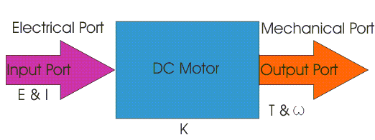
DC Motor or Direct Current Motor:

Slide 21
The electric motor operated by dc is called dc motor. This is a device that converts DC electrical energy into a mechanical energy.
When a current carrying conductor is placed in a magnetic field, it experiences a torque and has a tendency to move. In other words, when a magnetic field and an electric field interact, a mechanical force is produced.
The DC motor or direct current motor works on that principal. This is known as motoring action.
The direction of rotation of a this motor is given by Fleming’s left hand rule, which states that if the index finger, middle finger, and thumb of your left hand are extended mutually perpendicular to each other and if the index finger represents the direction of magnetic field, middle finger indicates the direction of current, then the thumb represents the direction in which force is experienced by the shaft of the DC motor.

Slide 22
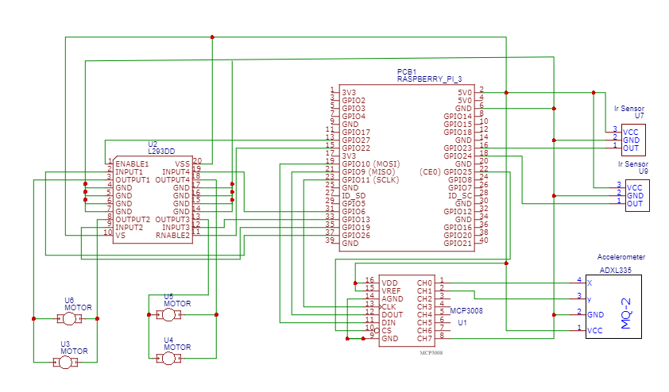
Circuit Diagram

Slide 23
Software Used
Python:
Python is a widely used general-purpose, high level programming language. It was initially designed by Guido van Rossum in 1991 and developed by Python Software Foundation. It was mainly developed for emphasis on code readability, and its syntax allows programmers to express concepts in fewer lines of code.
Python is a programming language that lets you work quickly and integrate systems more efficiently.

Slide 24
Why Python?
Python works on different platforms (Windows, Mac, Linux, Raspberry Pi, etc).
Python has a simple syntax similar to the English language.
Python has syntax that allows developers to write programs with fewer lines than some other programming languages.
Python runs on an interpreter system, meaning that code can be executed as soon as it is written. This means that prototyping can be very quick.
Python can be treated in a procedural way, an object-orientated way or a functional way.

Slide 25
Conclusion
A functional prototype of a system to detect slow voluntary blinking was analyzed and tested. It was possible to obtain a reliability of 100 % in the measurements of the position and movement of a simulated wheelchair. The communication between the Raspberry and the IoT was successful and the IoT ThingSpeak platform worked following all given specifications.

Slide 26
References
[1] I.-I. N. de Estad´ıstica y Censo, “Encuesta nacional sobre discapacidad 2018,” May 2019. [Online]. Available: https://http://inec.cr/sites/default/files/documetos-bibliotecavirtual/ reenadis2018.pdf
[2] S. Shinde, S. Kumar, and P. Johri, “A review: Eye tracking interface with embedded system iot,” in 2018 International Conference on Computing, Power and Communication Technologies (GUCON), Sep. 2018, pp. 791–795.
[3] U. Garg, K. K. Ghanshala, R. C. Joshi, and R. Chauhan, “Design and implementation of smart wheelchair for quadriplegia patients using iot,” in 2018 First International Conference on Secure Cyber Computing and Communication (ICSCCC), Dec 2018, pp. 106–110.
[4] A. Carrasquilla-Batista, K. Quir´os-Espinoza, and C. G´omez-Carrasquilla, “An internet of things (iot) application to control a wheelchair through eeg signal processing,” in 2017 International Symposium on Wearable Robotics and Rehabilitation (WeRob), Nov 2017, pp. 1–1.

Slide 27
[5] S. Khandani, “Engineering design process, education transfer plan,” 2005. [Online].Available:https://www.dphu.org/uploads/attachements/books/books25470.pdf
[6] M. Varela, “Raw eeg signal processing for bci control based on voluntary eye blinks,” in 2015 IEEE Thirty Fifth Central American and Panama Convention (CONCAPAN XXXV), Nov 2015, pp. 1–6. Authorized
[7]WHEELCHAIR CONTROL THROUGH EYE- BLINKING AND IOT PLATFORM was published in International Journal of Scientific Research in Engineering and Management (IJSREM) Volume 05, Issue 04, April 2021 by Jeya Gokul CS,Alagu Sriram S,Saravana Pandi P and Krishnamurthy M. Paper:http://ijsrem.com/download/wheelchair-control-through-eye-blinking-and-iot-platform/?wpdmdl=5427&masterkey=6076e42a056fc

